Slide 1
CSE 105 theory of computation
Fall 2020 Week 5

Slide 2
Table of Contents – Quickly Jump to a video’s slides
Monday | Wednesday | Friday
Video 57 | Video 63 | Video 68
Video 58 | Video 64 | Video 69
Video 59 | Video 65 | Video 70
Video 60 | Video 66 | Video 71
Video 61 | Video 67 | Examples
Video 62 | Examples | FAQ
Examples | FAQ
FAQ

Slide 3
This week’s learning goals
Identify the components of a formal definition of a context-free grammar (CFG)
Derive strings in the language of a given CFG
Determine the language of a given CFG
Design a CFG generating a given language
Identify when a CFG is ambiguous
Prove the closure of class of CFLs under certain operations
Motivate the definition of a Turing machine
Trace the computation of a Turing machine on given input
Describe the language recognized by a Turing machine

Slide 4
Monday
Videos 057-062
Today's learning goals
Identify the components of a formal definition of a CFG
Derive strings in the language of a given CFG
Determine the language of a given CFG
Design a CFG generating a given language
Today's textbook sections
Sipser 2.1 Introduction (page 102)

Slide 5
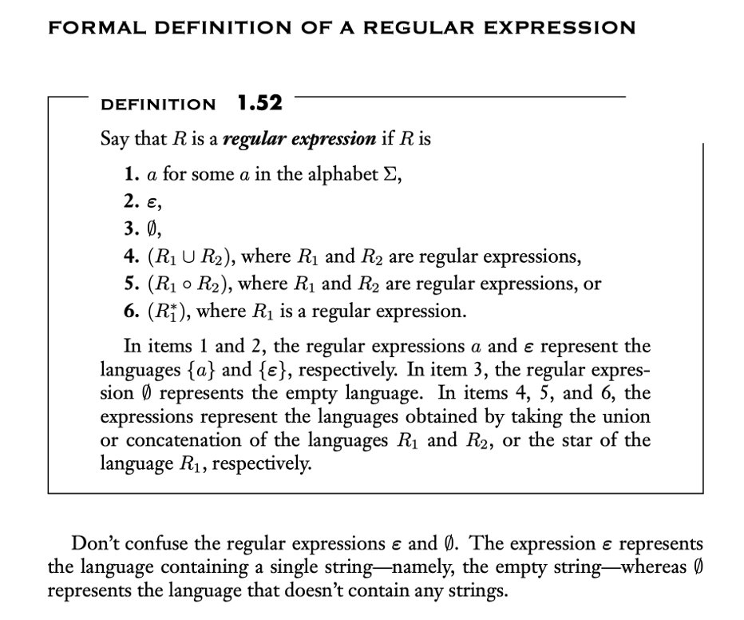
057.CSE105.CFGIntroduction.mp4
Prior definitions to remember before watching this video:
Definition from Sipser 1.3

Slide 6
The next model of computation
Idea: allow some memory of unbounded size
How?
Generalization of regular expressions → Context-free grammars
Generalization for (D or N)FA → Pushdown Automata
*Machines process strings L to R but grammars can start at the middle, R, L, etc.*

Slide 7
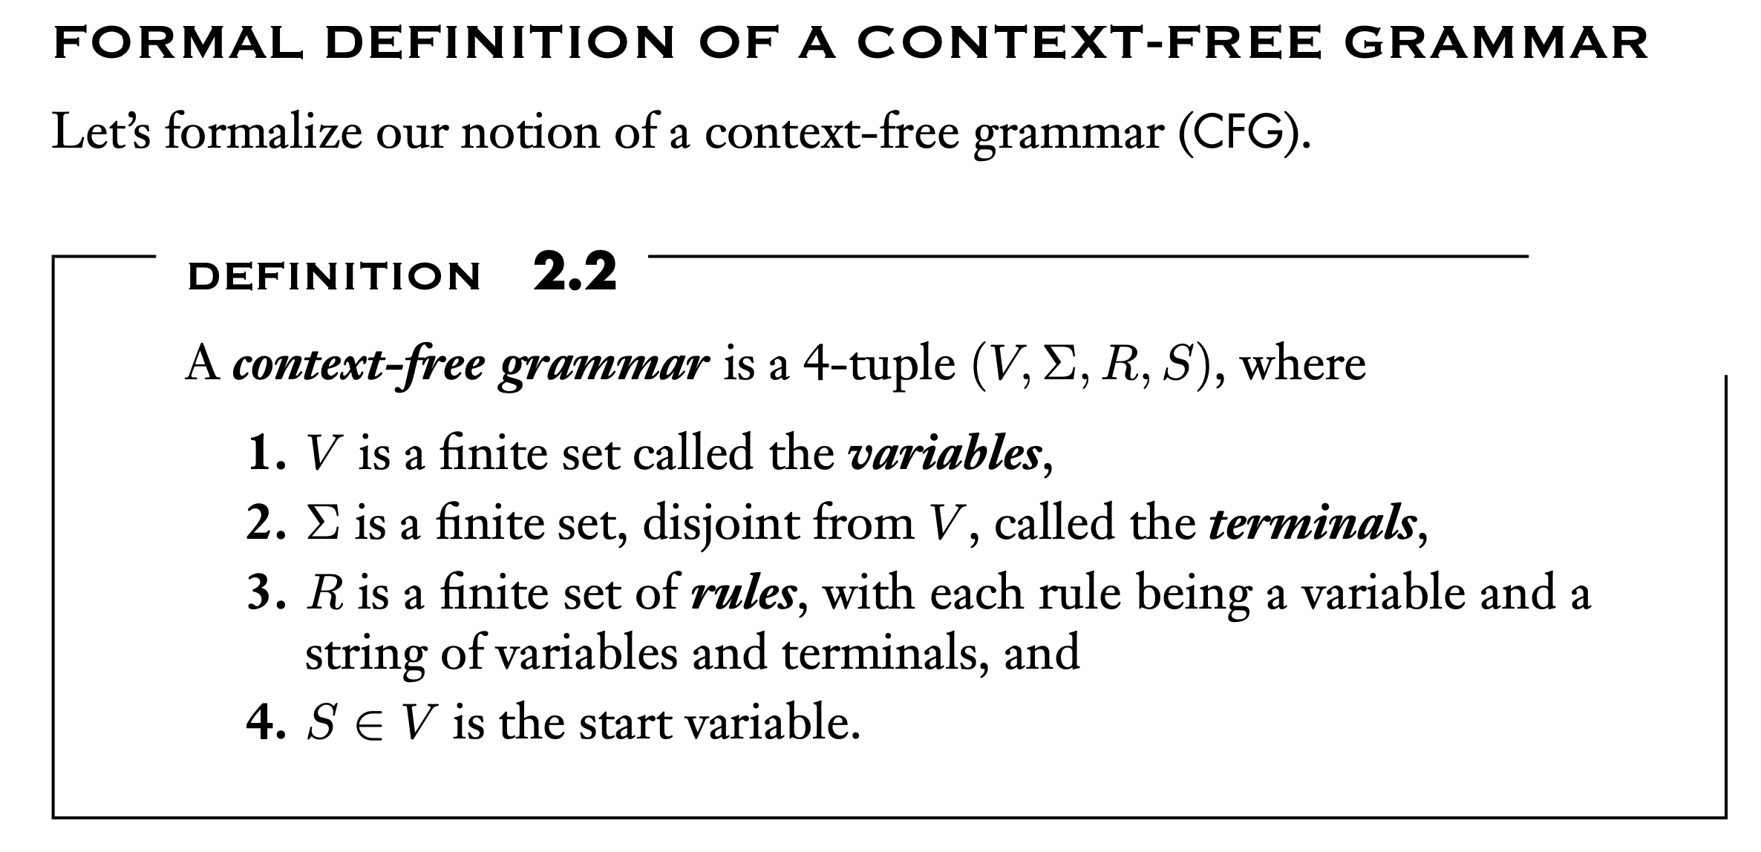
Key Notation and Definitions (057)
Definition from Sipser 2.1

Slide 8
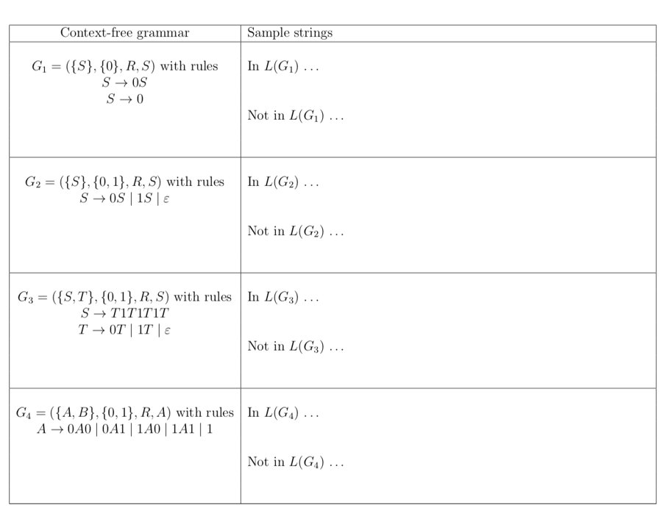
058.CSE105.CFGExample1.mp4
Example to be presented in video 058

Slide 9
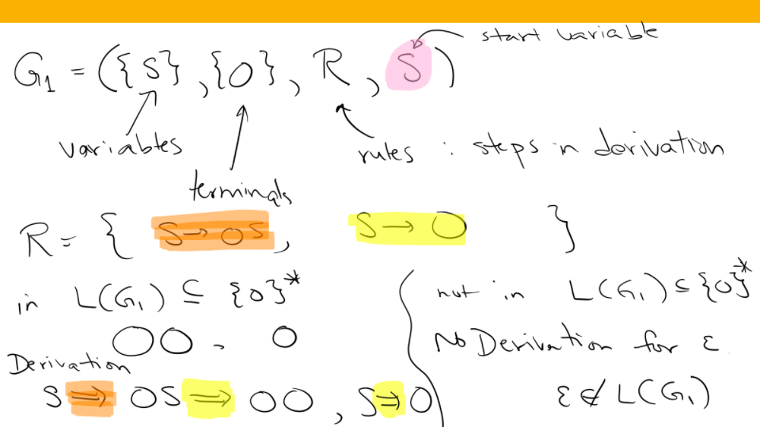

Slide 10
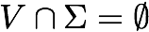
Context-free grammar Sipser Def 2.2, page 102
(V, Σ, R, S)
Variables: nonempty finite set of (usually upper case) variables V
Terminals: nonempty finite set of alphabet symbols Σ
Rules/Productions: finite set of allowed transformations R
Start variable: origination of each derivation S

Slide 11
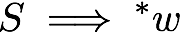
Context-free language Sipser p. 104
The language generated by a CFG (V, Σ, R, S) is
{ w in Σ* | starting with the Start variable and applying sequence of rules, can derive w on RHS}
If G = (V, Σ, R, S)
the language generated by G is denoted L(G).
Notation:
Terminology: sequence of rule applications is derivation

Slide 12
Key Notation and Definitions (058)
Single line in arrow. This is where we define a rule.
A==> u
Double line in arrow. One step in derivation. When we use the rule.
At each step in the derivation (sequence of rule applications), choose one variable in our current intermediate string.
Take one instance of one variable, pick a rule that has that variable on its left-hand side, and replace that instance of variable with the right-hand side of the rule.

Slide 13
059.CSE105.CFGExample2.mp4
Remember:
The language of a grammar is the set of strings it generates.

Slide 14
Context-free language Sipser p. 104
What is the language of the CFG ({S}, {0,1}, R, S) with rules
S → 0S
S → 1S
S → ε
L(0*1*)
L(0* U 1*)
L( (0 U 1)*)
L ( (0*1*)* )
I don't know.
S → 0S | 1S | ε

Slide 15
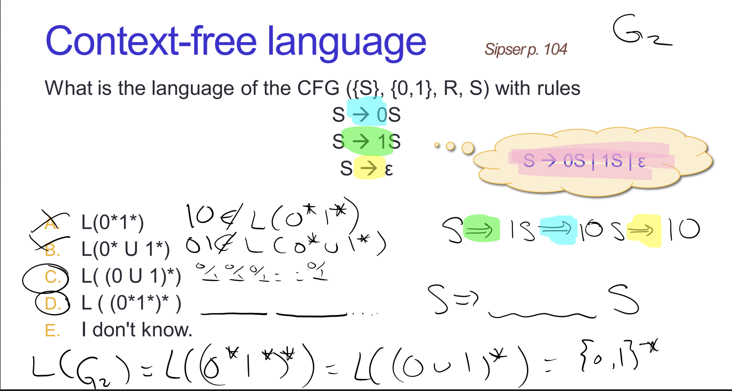

Slide 16
Key Notation and Definitions (059)
In this example, we built a string from left to right using rules and replaced S with the empty string in the end. We got a derivation for every possible string over the symbol 0 and 1.

Slide 17
060.CSE105.CFGExample3.mp4
Prior definitions to remember before watching this video:
CFG ({S}, {0,1}, R, S) with rules
S → 0S
S → 1S
S → ε
S → 0S | 1S | ε
(Abbreviation of rules on the left)

Slide 18
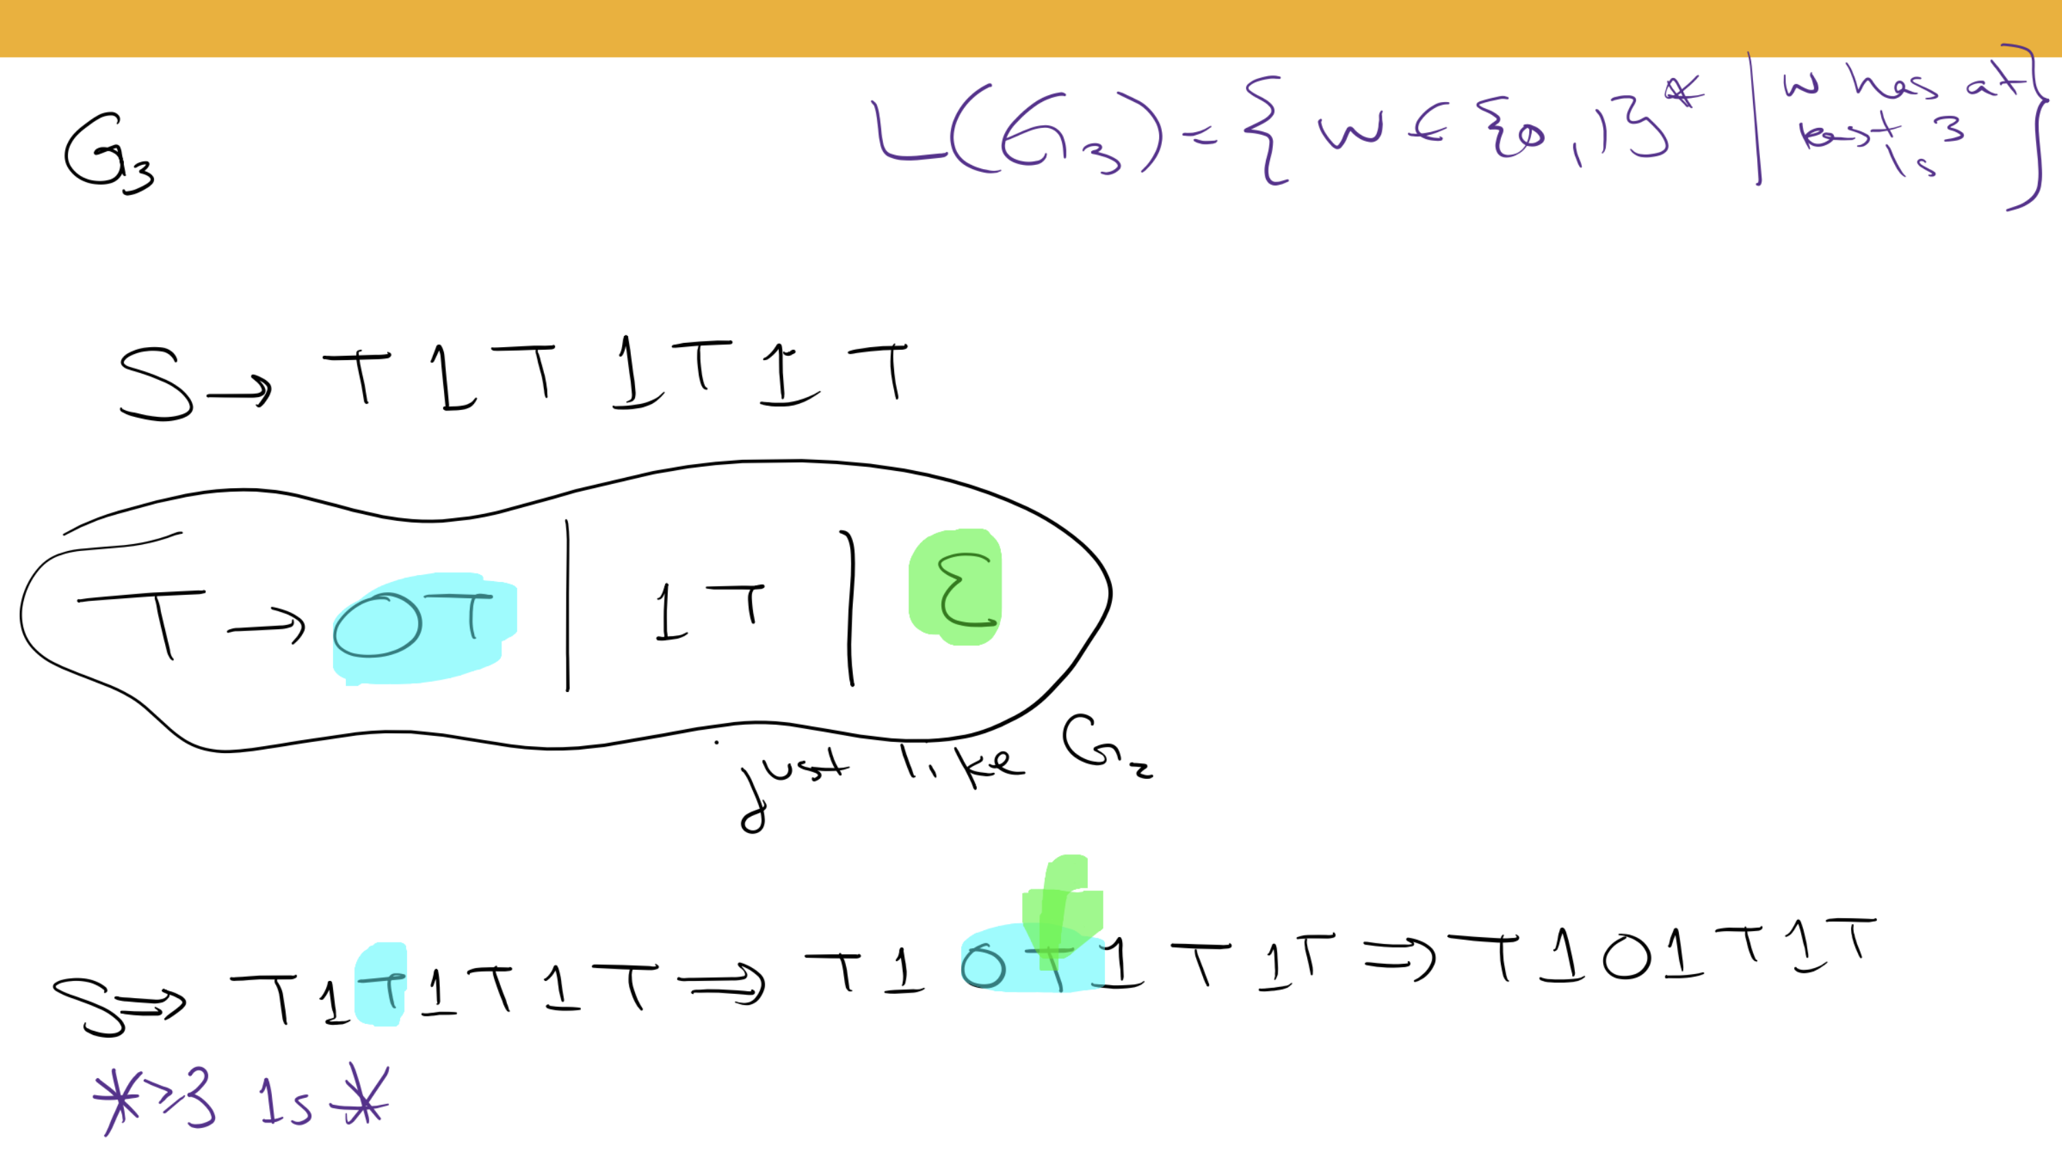

Slide 19
Key Notation and Definitions (060)
Every time we take another step in our derivation, it’s totally up to us which instance of which variable we choose to replace.

Slide 20
061.CSE105.CFGExample4.mp4
Remember:
∅ represents the language that doesn’t contain any strings.
Definition from Sipser 2.1

Slide 21
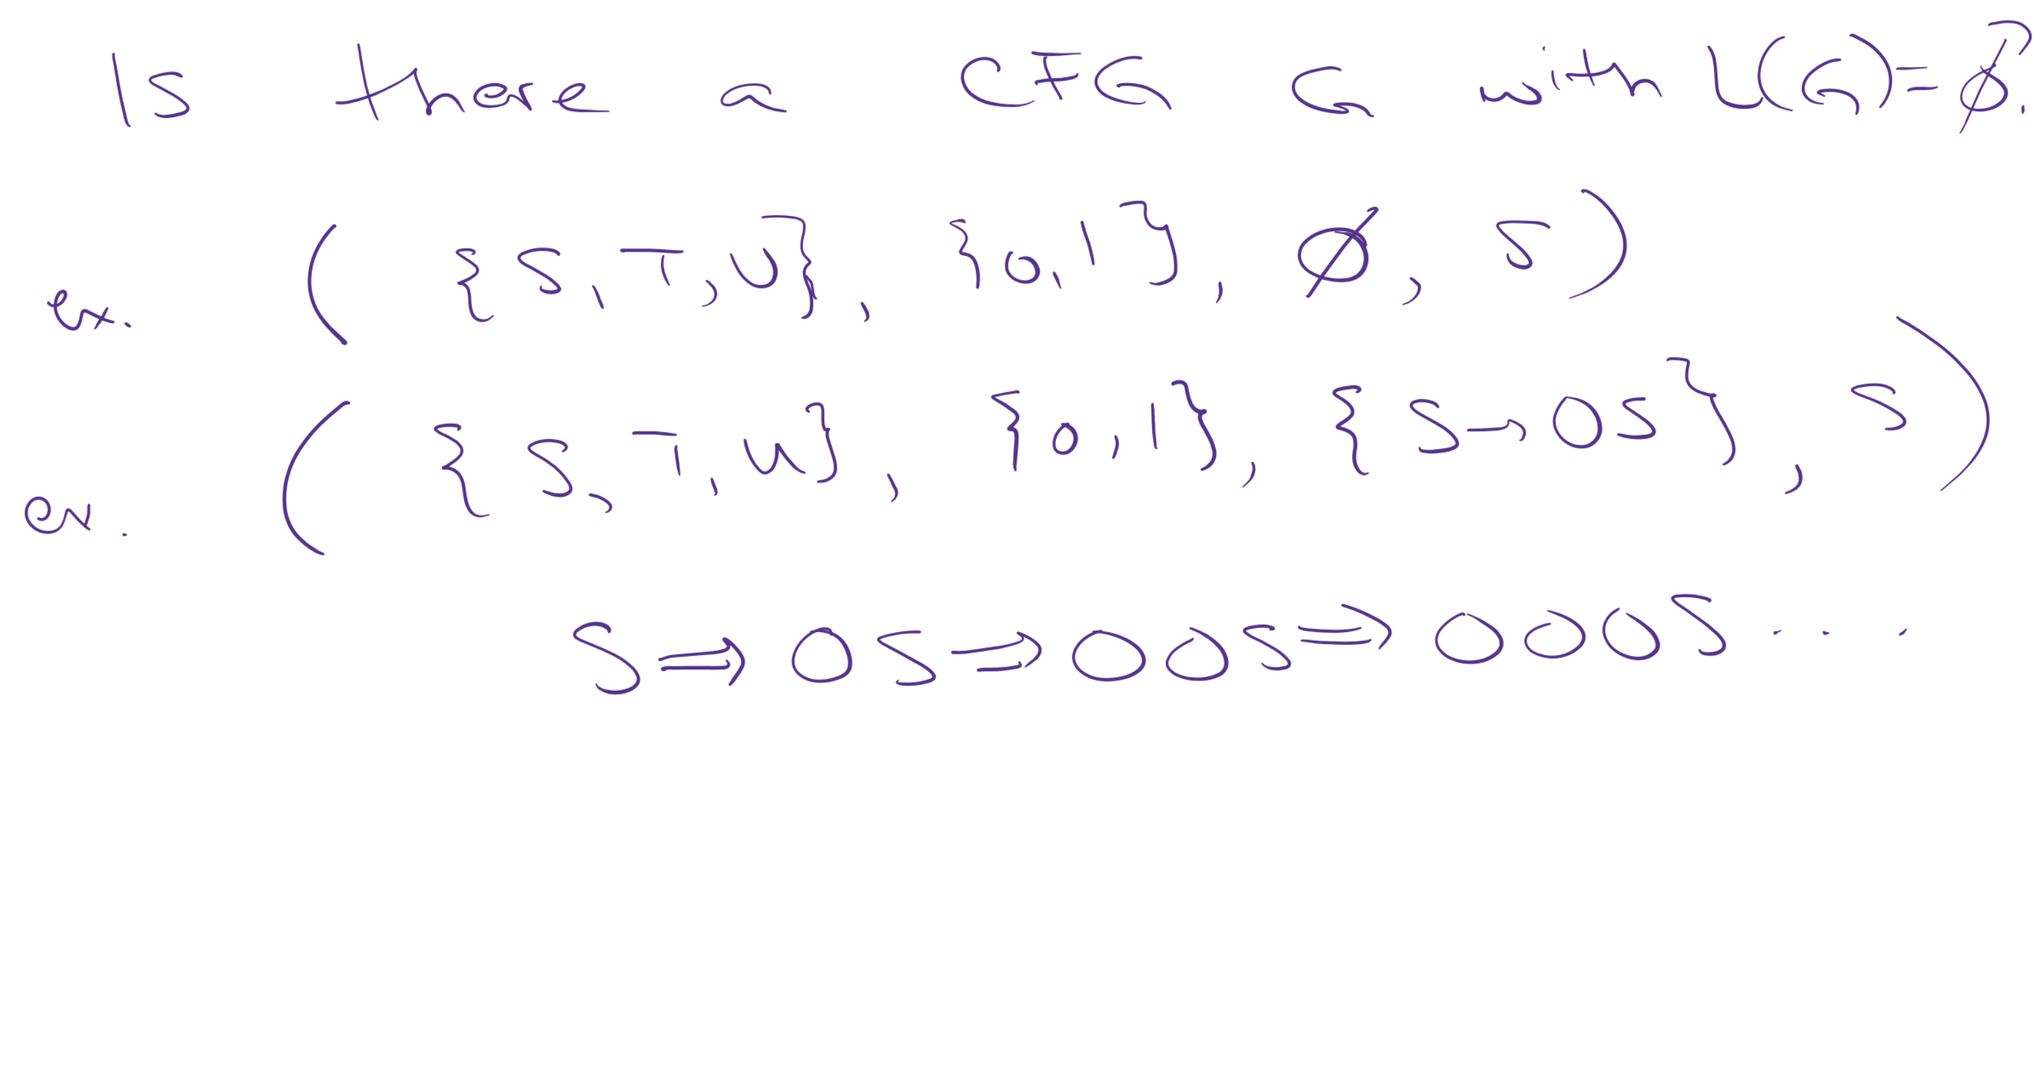
L(G) is the language recognized by the CFG, G.
Each of these grammars generate the empty set.

Slide 22
Key Notation and Definitions (061)
The set of rules can be the empty set (no rules).
If the rules only produce derivations that never end, then the grammar generates the empty set because there won’t be any derivation for any string that can witness if that string is in the language generated by the grammar.

Slide 23
062.CSE105.CFGDesignExample.mp4

Slide 24
Designing a CFG
L = { abba }
Which CFG generates L?
( {S, T, V, W} , {a, b}, {S → aT , T → bV , V → bW , W → a }, S )
( {Q}, {a,b}, { Q → abba } , Q)
( {X, Y} , {a,b}, { X → aYa , Y → bb } , X)
All of the above
None of the above

Slide 25
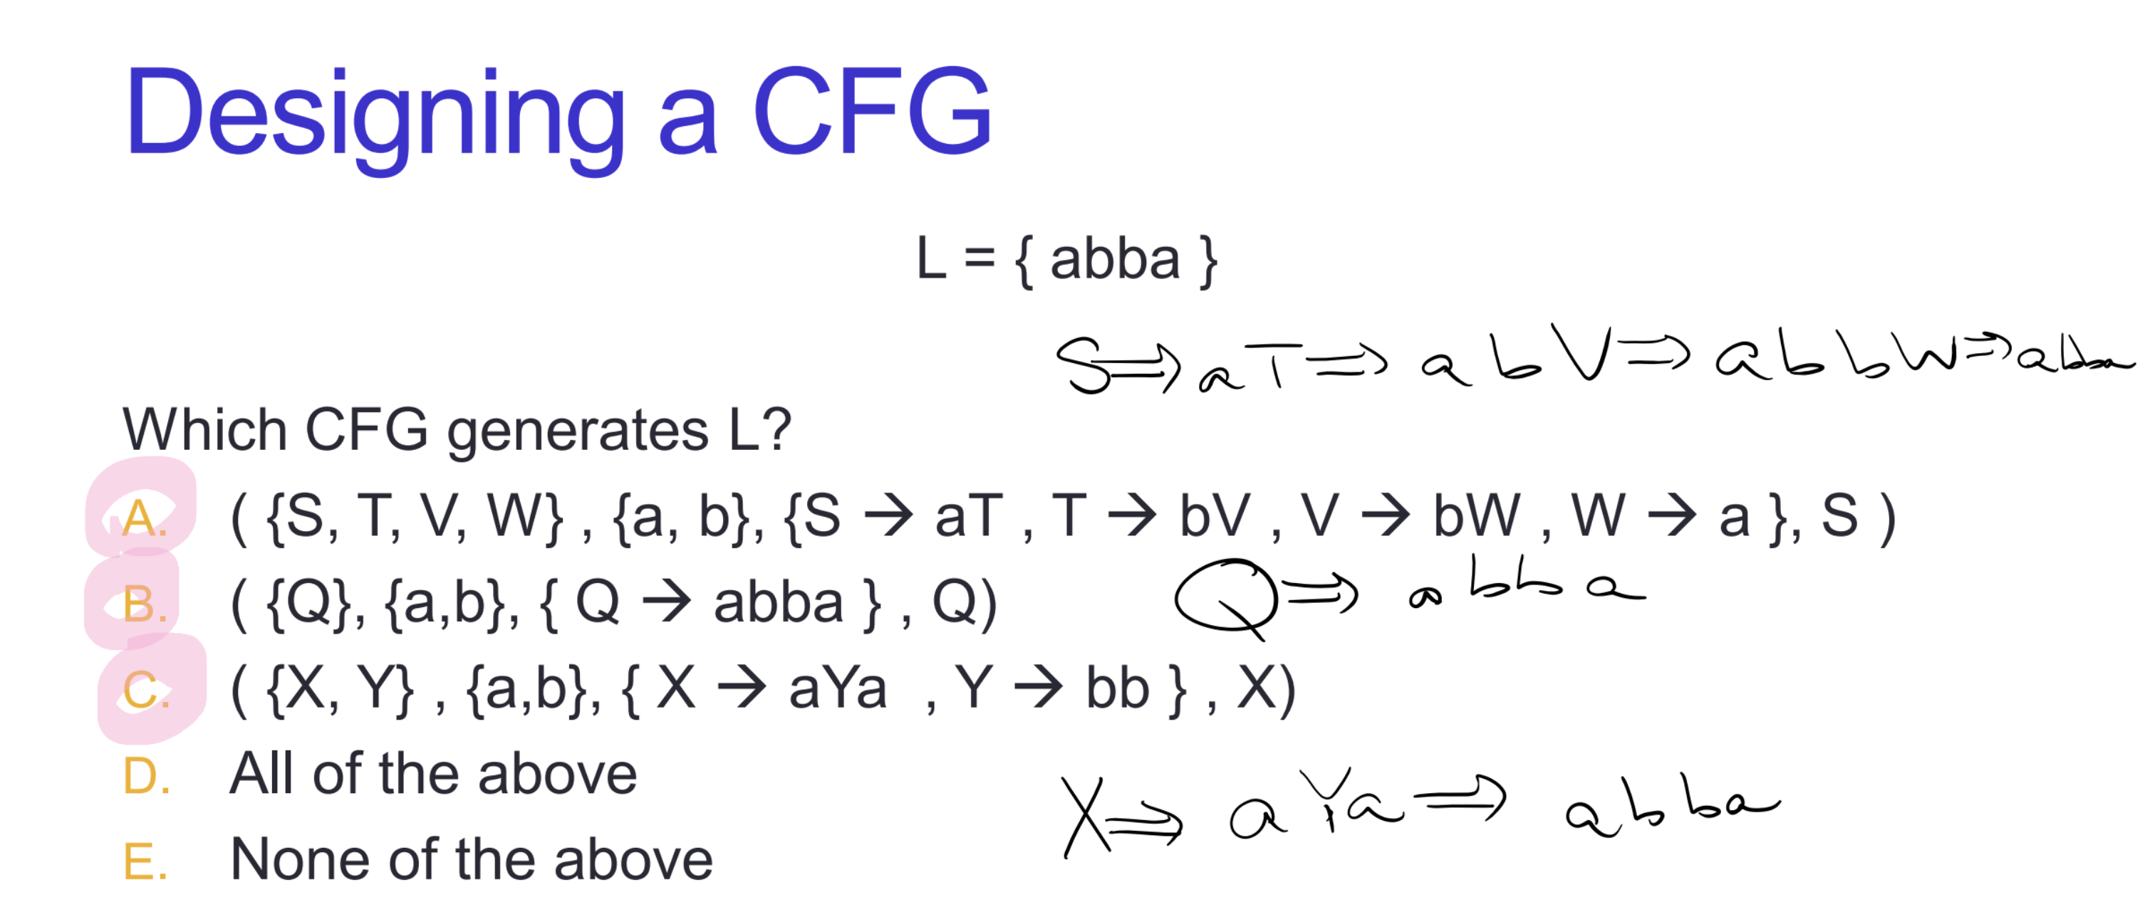

Slide 26
Key Notation and Definitions (062)
Designing a context-free grammar requires creativity. We saw three different approaches in the video.
We have rules that go from left to right to produce the string.
We have terminals that surround a variable.
We can also hardcode the rules.

Slide 27
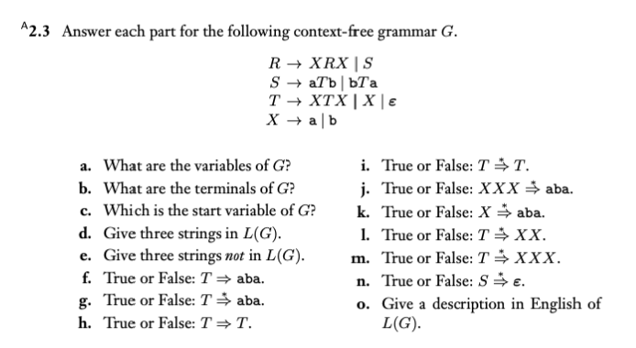
Practice with a CFG
Example 1
Ch. 2 Exercises pg. 155

Slide 28
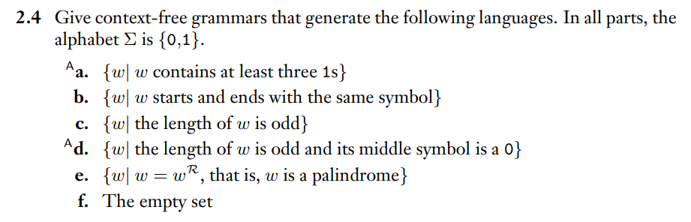
CFG Design
Example 2
Ch. 2 Exercises pg. 155

Slide 29
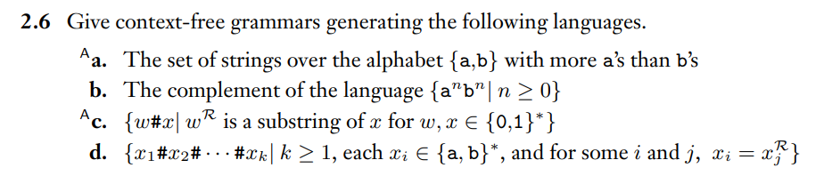
More CFG Design
Example 3
Ch. 2 Exercises pg. 155

Slide 30
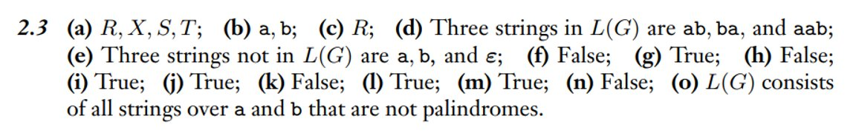
Example 1 Solution
Ch. 2 Solutions pg. 160

Slide 31
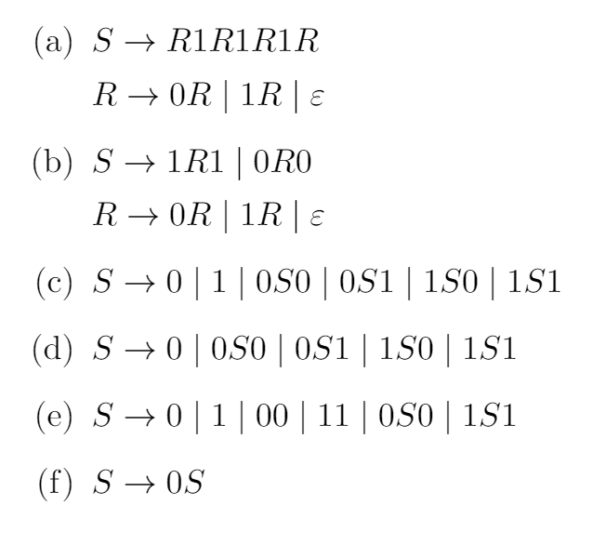
Example 2 Solution
Following the book's convention, the set of rules is used to abbreviate the CFG. Note that there are multiple correct answers for each part.

Slide 32
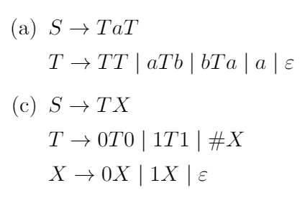
Example 3 Solution
Following the book's convention, the set of rules is used to abbreviate the CFG. Note that there are multiple correct answers for each part.

Slide 33
Monday FAQ (057-062)
Q: Will the strings in the grammar be of finite length?
A: Any string that's in the grammar must have a derivation. Each derivation is of finite length, but there can be infinitely many of these derivations that exist.

Slide 34
Wednesday
Video 063-067
Today’s learning goals
Identify when a CFG is ambiguous
Prove the closure of class of CFLs under certain operations
Today’s textbook sections
Sipser 2.2 paragraph at the top of page 117

Slide 35

063.CSE105.CFGDesignForNonregularLanguage.mp4
Remember:
Regular Language: A language that can be expressed using a regular expression.
Context-free language (CFL): A language generated by a CFG.
Context-free grammar (CFG): A 4-tuple (V, Σ, R, S) of the set of variables, the set of terminals, the set of rules, and the start variable.
Regular expression def. from section 1.3

Slide 36
Designing a CFG
We know this set is not regular!
(because DFA/NFA can’t “remember” how many ‘a’ it has read)
L = { a^{n}b^{n} | n ≥ 0 }
One approach:
what is shortest string in the language?
how do we go from shorter strings to longer ones?

Slide 37
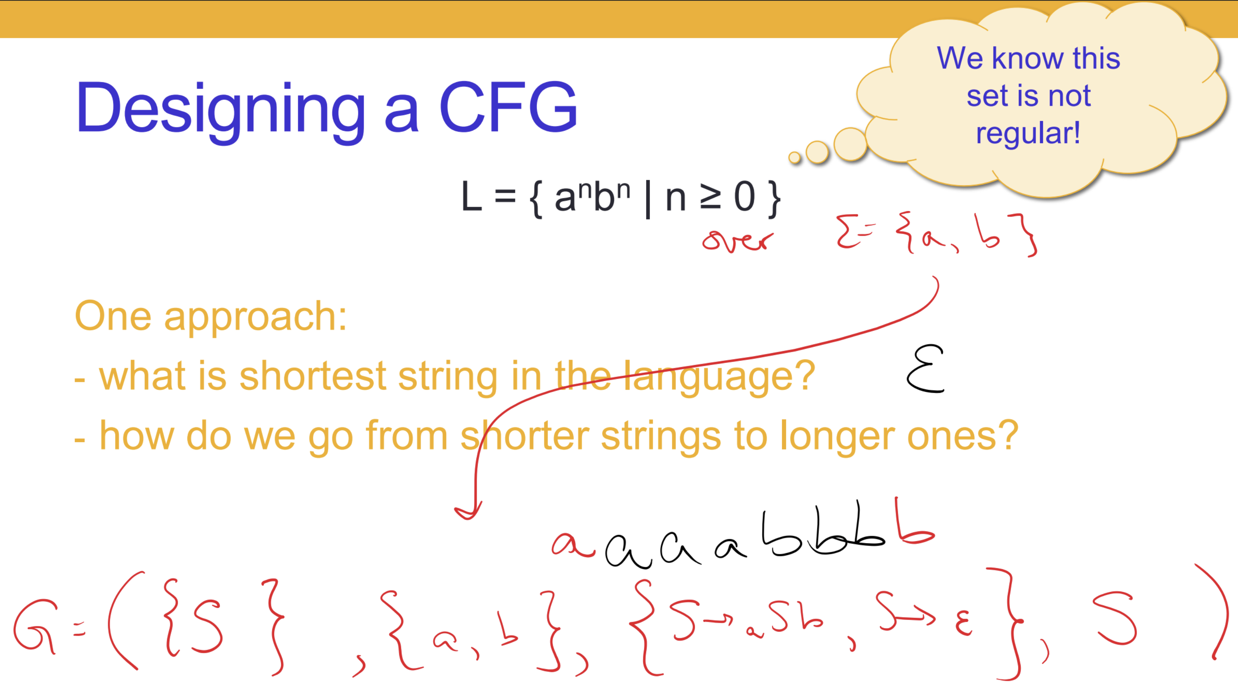

Slide 38
Key Notation and Definitions (063)
Fact: Every regular language is a context-free language.
Fact: There are context-free languages that are nonregular.

Slide 39
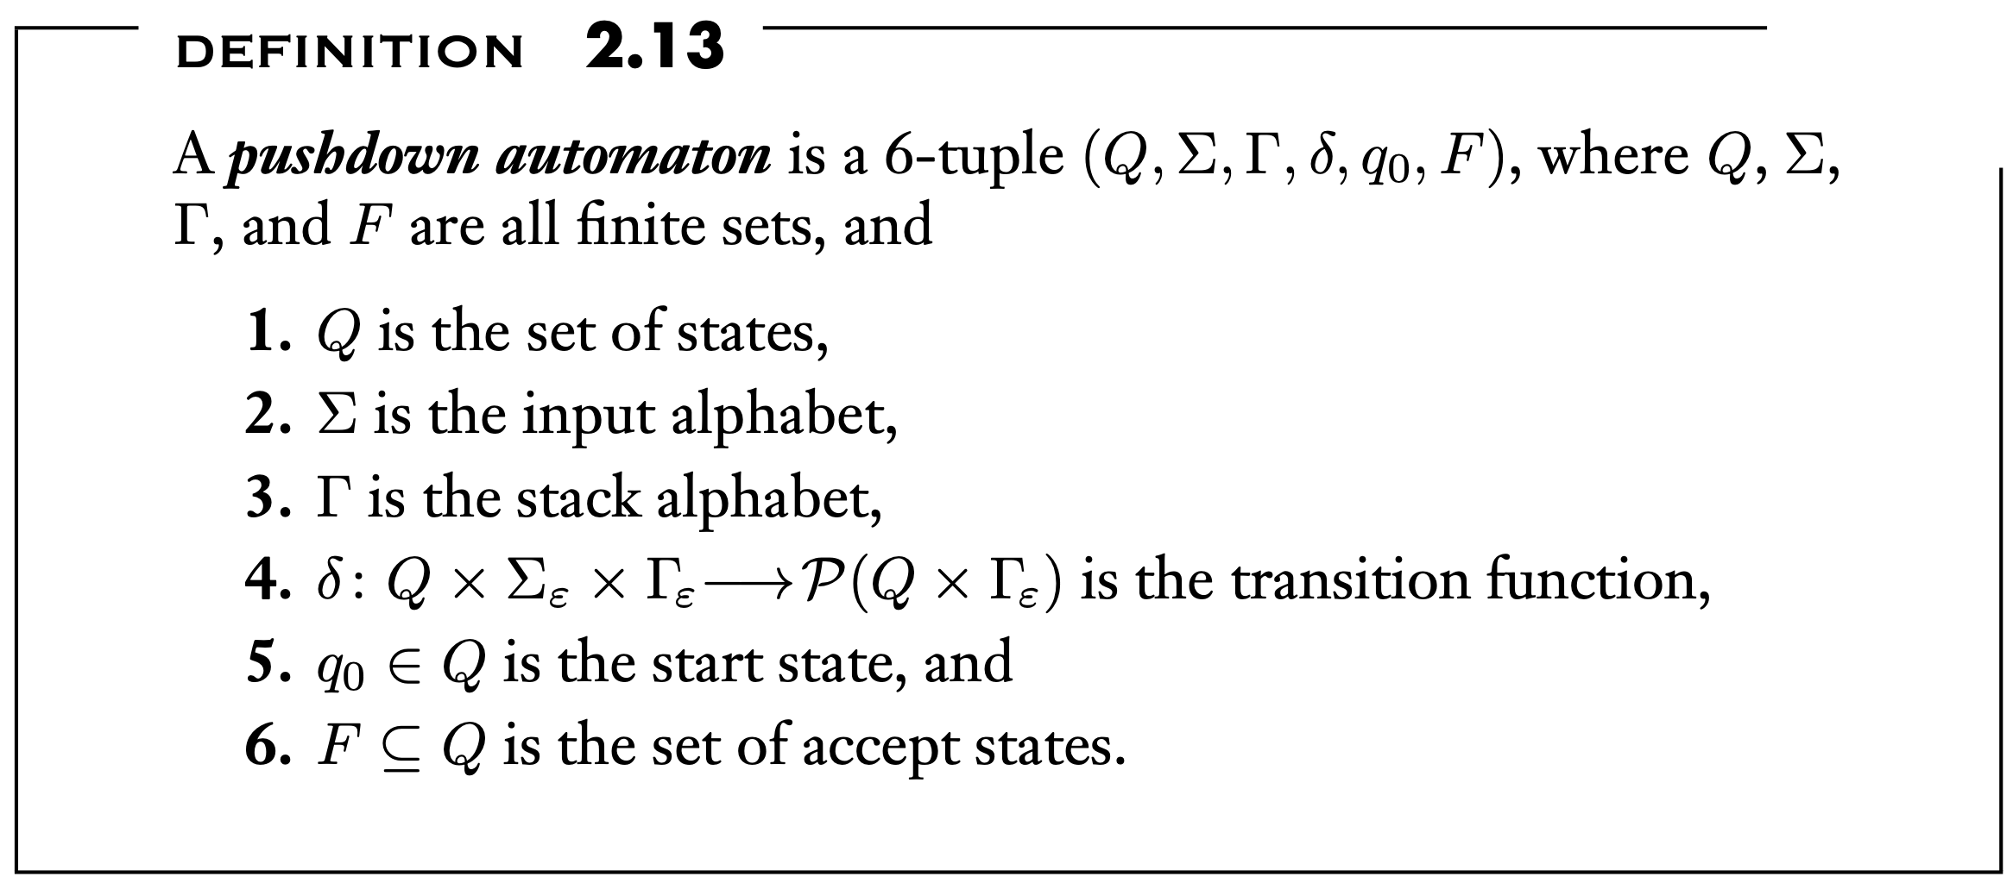
064.CSE105.ContextFreeLanguagesIntro.mp4
Review PDA:
Think as an NFA + stack
At each step:
-Transition to the new state based on the current state, the symbol read, and the symbol at the top of the stack.
-(Possibly) push and/or pop a symbol to/from the top of the stack.

Slide 40
Context-free languages
L ( 00*)
L( (0U1)* )
{w | w has at least three 1s}
{ abba }
{ a^{n}b^{n} | n ≥ 0 }
Ex: { a^{i}b^{j} | j ≥ i ≥ 0 } recognizable by a PDA

Slide 41
PDAs and CFGs are equally expressive
Theorem 2.20: A language is context-free if and only if some PDA recognizes it.
Consequences
Quick proof that every regular language is context free
To prove closure of class of CFLs under a given operation, can choose two modes of proof (via CFGs or PDAs) depending on which is easier

Slide 42
Key Notation and Definitions (064)
PDAs and CFGs are equally expressive.
A language is context-free if and only if some PDA recognizes it.
The set of all context-free languages is identical to the set of all languages accepted by PDA.
For a given CFG, you can produce a PDA for that CFG and the corresponding CFL.
When building a grammar that generates some language, the alphabet ({a, b} in this case) the language is over is the set of terminals.

Slide 43
065.CSE105.CFLApplications.mp4

Slide 44
CFGs in practice
Compilers and rendering
Syntax of programming languages
Parsing (markup) languages
Natural language processing
“They read a book with a magnifying glass”
Paper generation URL: https://pdos.csail.mit.edu/archive/scigen/

Slide 45
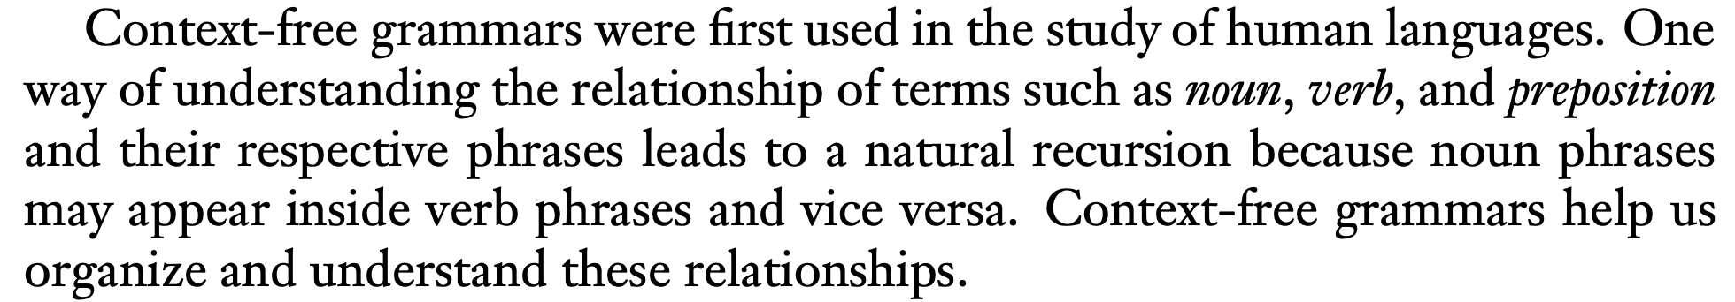
Key Notation and Definitions (065)
Optional background information from section 2, pg.101
Read more on pg.101, section 2

Slide 46
066.CSE105.CFLClosure.mp4
Remember:
Context-free grammar (CFG): A 4-tuple (V, Σ, R, S) of the set of variables, the set of terminals, the set of rules, and the start variable.
Context-free language (CFL): Language generated by a CFG or recognized by a PDA.
Push-down automaton (PDA): NFA + stack
At each step:
-Transition to the new state based on the current state, the symbol read, and the symbol at the top of the stack.
-(Possibly) push and/or pop a symbol to/from the top of the stack.

Slide 47
More complicated language
{a^{n}b^{m} | n ≠ m}
Can rewrite as:
{a^{n}b^{m} | n > m} U {a^{n}b^{m} | n < m}

Slide 48
Closure under union
If G₁ = (V₁, Σ, R₁, S₁) and G₂ = (V₂, Σ, R₂, S₂) are CFGs
and G₁ generates L₁, G₂ generates L_{2,} how can we combine the grammars so we generate L₁ U L₂ ?
G = (V₁ U V₂, Σ, R₁ U R₂, S₁ U S₂)
G = (V₁ x V₂, Σ, R₁ x R₂, (S₁, S₂) )
G = (V1 U V2 U {S0}, Σ, R₁ U R₂ U {S0 → S1, S0 → S2}, S0)
More than one of the above
We might not always be able to: the class of context-free languages might not be closed under union.

Slide 49
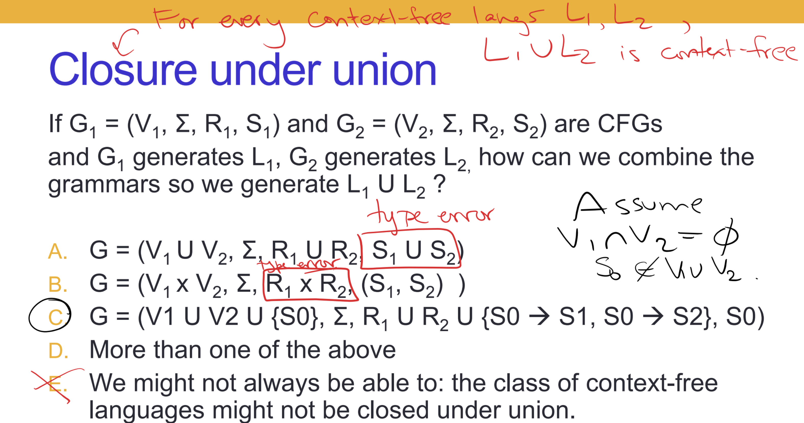

Slide 50
Closure
The class of context-free languages over Σ is closed under …
Complementation, by flipping accept/ reject states of PDA.
Union, by adding a spontaneous move from a new start state to the start states.
Concatenation, by adding spontaneous moves from accept states of one machine to the start state of the second.
Kleene star, by adding a fresh start state and spontaneous moves from accept states to the old start state.
I don't know.

Slide 51
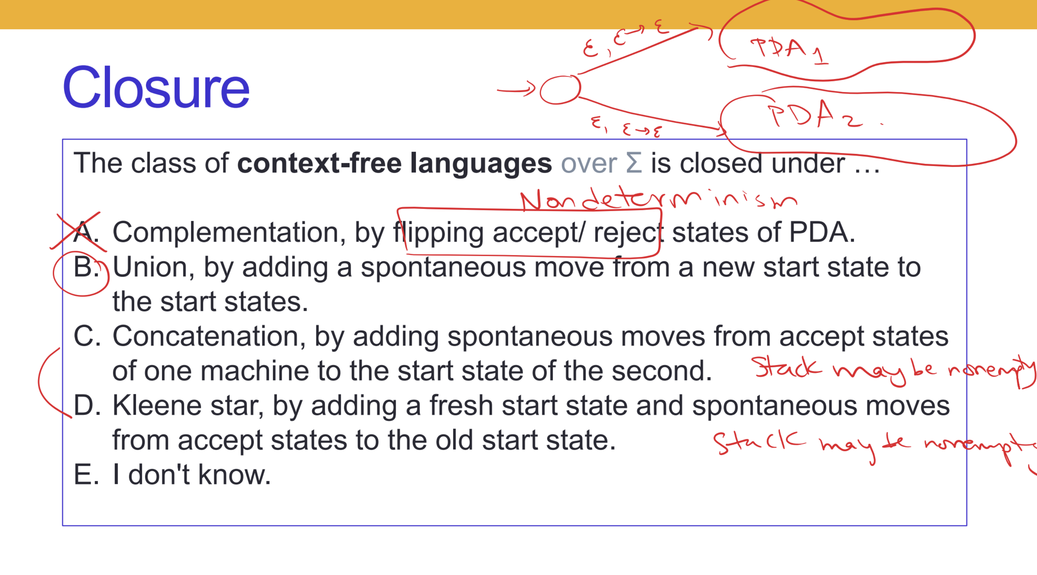
Spontaneous move PDA have the power of non-determinism.

Slide 52
Closure under concatenation
If G₁ = (V₁, Σ, R₁, S₁) and G₂ = (V₂, Σ, R₂, S₂) are CFGs
and G₁ generates L₁, G₂ generates L_{2,} how can we combine the grammars so we generate L₁ L₂ ?

Slide 53
Summary
A language L is
Regular iff it is described by some regular expression
iff it is recognized by some DFA
iff it is recognized by some NFA
Context-free iff it is recognized by some PDA
iff it is generated by some CFG

Slide 54
What's left?
Fact: Every regular language is a context-free language.
Fact: There are context-free languages that are nonregular.
Fact: There are countably infinitely many regular languages.
Fact: There are countably infinitely many context-free languages.
Most languages are not context-free languages!

Slide 55
Closure properties of …
The class of regular languages is closed under
Union
Concatenation
Star
Reversal
Intersection
Complementation
Difference
The class of context-free languages is closed under
Union
Concatenation
Star
Reversal
The class of context-free languages is not closed under
Intersection
Complementation
Difference

Slide 56
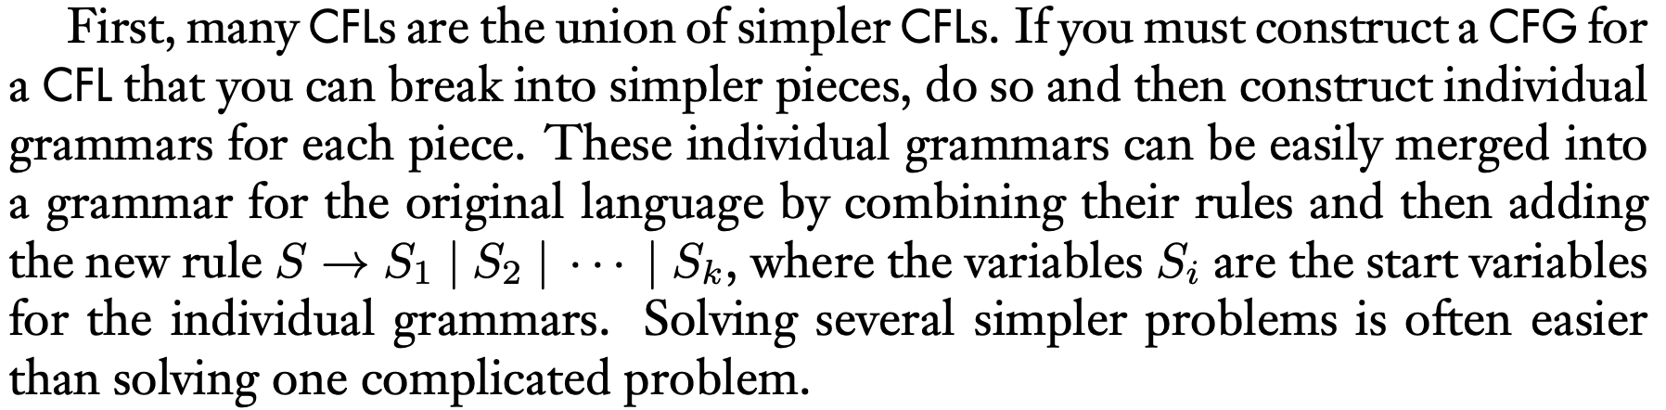
Key Notation and Definitions (066)
The set of context-free languages is closed under union. For every context-free language L1 and L2, L1 U L2 is also context free.
The set of context-free languages is also closed under Concatenation, Star, and Reversal.
Optional Reading: Application of CFL’s closure properties.
Read more on pg.107, section 2.1

Slide 57
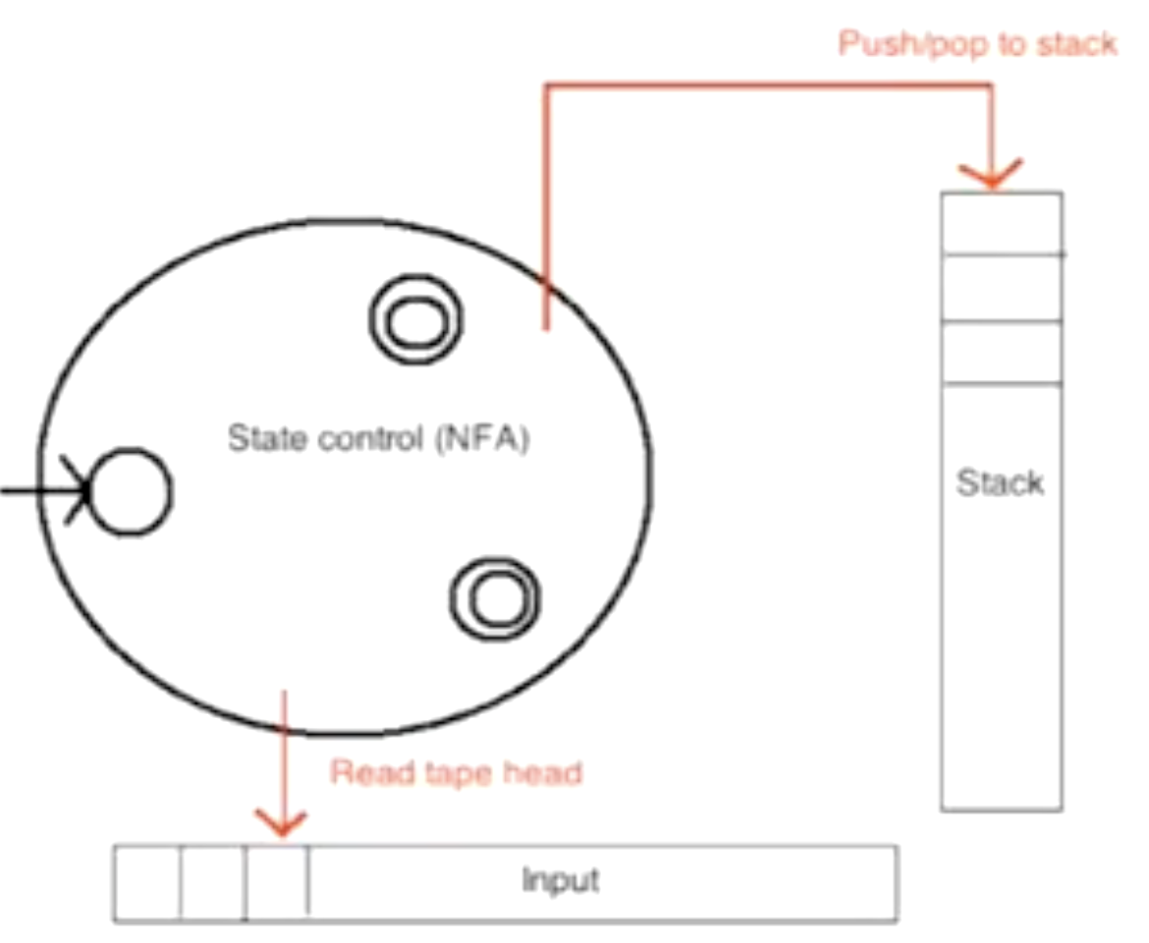
067.CSE105.NonContextFreeLanguages.mp4
Remember:
PDA uses a stack, that inserts and removes according to the last-in-first-out (LIFO) principle.

Slide 58
Closure properties of …
The class of regular languages is closed under
Union
Concatenation
Star
Reversal
Intersection
Complementation
Difference
The class of context-free languages is closed under
Union
Concatenation
Star
Reversal
The class of context-free languages is not closed under
Intersection
Complementation
Difference

Slide 59
Examples of non-context-free languages
{ a^{n}b^{n}c^{n} | 0 ≤ n } Sipser Ex 2.36
{ a^{i}b^{j}c^{k} | 0 ≤ i ≤ j ≤ k } Sipser Ex 2.37
{ w w | w is in {0,1}* } Sipser Ex 2.38
To prove, need Pumping lemma for CFLs (won't cover in CSE 105)

Slide 60
Key Notation and Definitions (067)
Something that might make a language not context-free:
Read a number from memory more than once. (e.g. { a^{n}b^{n}c^{n} | 0 ≤ n } )
Remember what’s at the beginning of a string. (e.g. { w w | w is in {0,1}* })

Slide 61
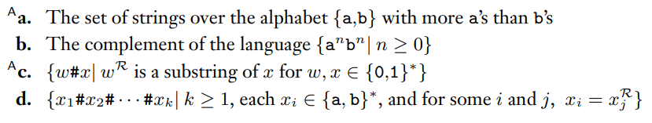
Describing PDAs Informally
Example 1
Ch. 2 Exercises pg. 155
The languages in Exercise 2.6 for reference

Slide 62
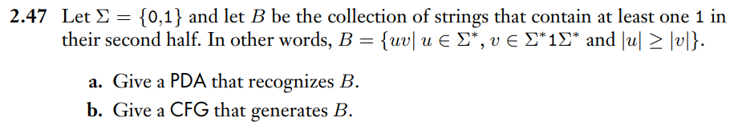
PDA and CFG Design
Example 2
Ch. 2 Problems pg. 159

Slide 63
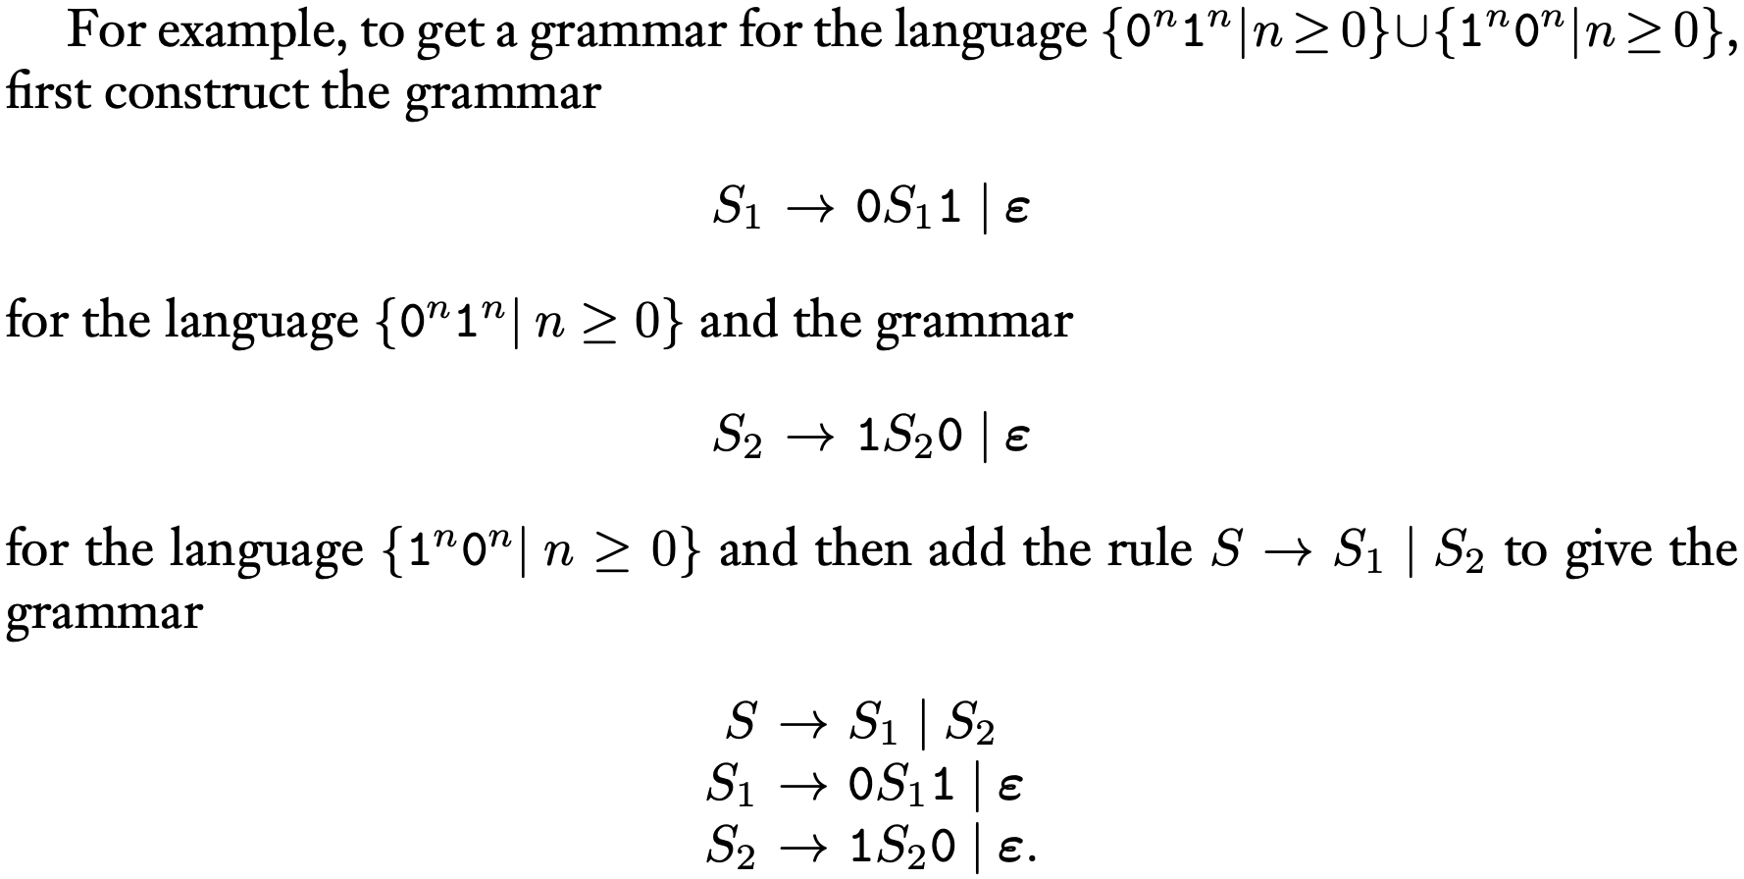
CFG Construction for Union
Example 3
Example from pg.106, section 2.1

Slide 64
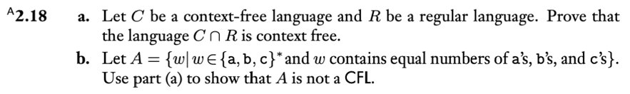
Proving that Languages are Context Free
Example 4
Ch. 2 Problems pg. 156

Slide 65
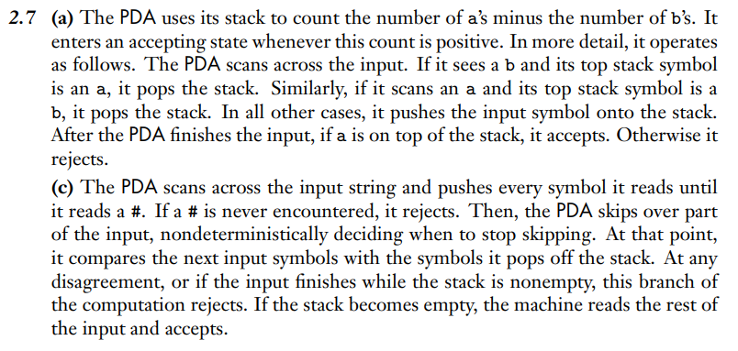
Example 1 Solution
Ch. 2 Solutions pg. 160

Slide 66
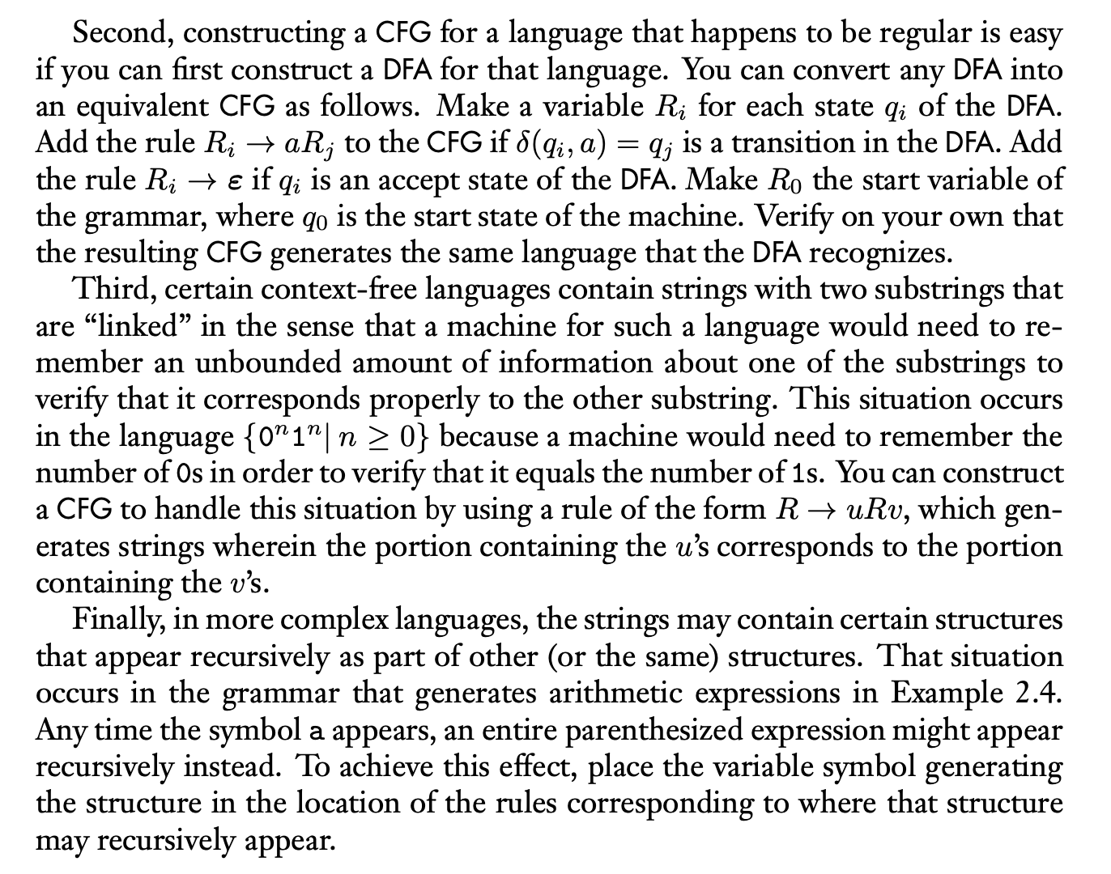
Example 3 Solution
Example from pg.10, section 2.1

Slide 67
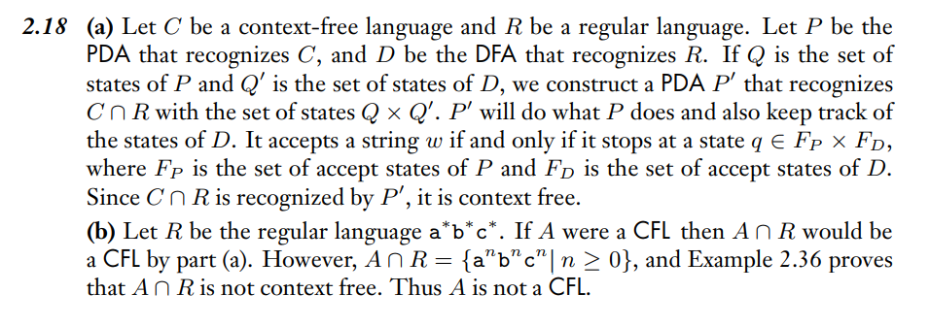
Example 4 Solution
Ch. 2 Solutions pg. 161

Slide 68
Wednesday FAQ (063-067)
Q: "What is a non-context free language and how do we recognize one?"
A: A non-context free language cannot be represented by any PDA or generated by any CFG. We are not covering the Context-free Pumping Lemma in this class, so we do not have a general technique for proving that a language is non-context free. But we have some examples of non-context free languages.
Q: “Can every context-free language be represented by some PDA?”
A: Yes, CFL and PDA are equally expressive models of computation.

Slide 69
Friday
Videos 068-071
Today’s learning goals
Motivate the definition of a Turing machine
Trace the computation of a Turing machine on given input
Describe the language recognized by a Turing machine
Today's textbook sections
Sipser 3.1 Introduction (pp. 166-167)

Slide 70
068.CSE105.TuringMachineIntro.mp4
Remember:
PDA is constrained to a stack (LIFO).
If we want less limitations, why not use two stacks? Or three stacks?
Or, why not choose a memory model that won’t erase anything when reading from memory?

Slide 71
Regular sets: not the end of the story
Context-free languages
Many nice / simple / important sets are not context-free
Limitation of the pushdown automaton model
Can't "count” Can only count one number at a time
Can only remember finitely far into the past
Can't backtrack
Must make decisions in "real-time"
We know computers are more powerful than this model…
Which conditions should we relax?

Slide 72
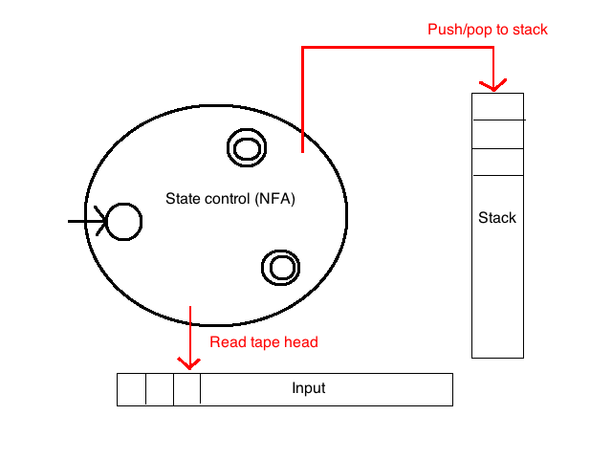
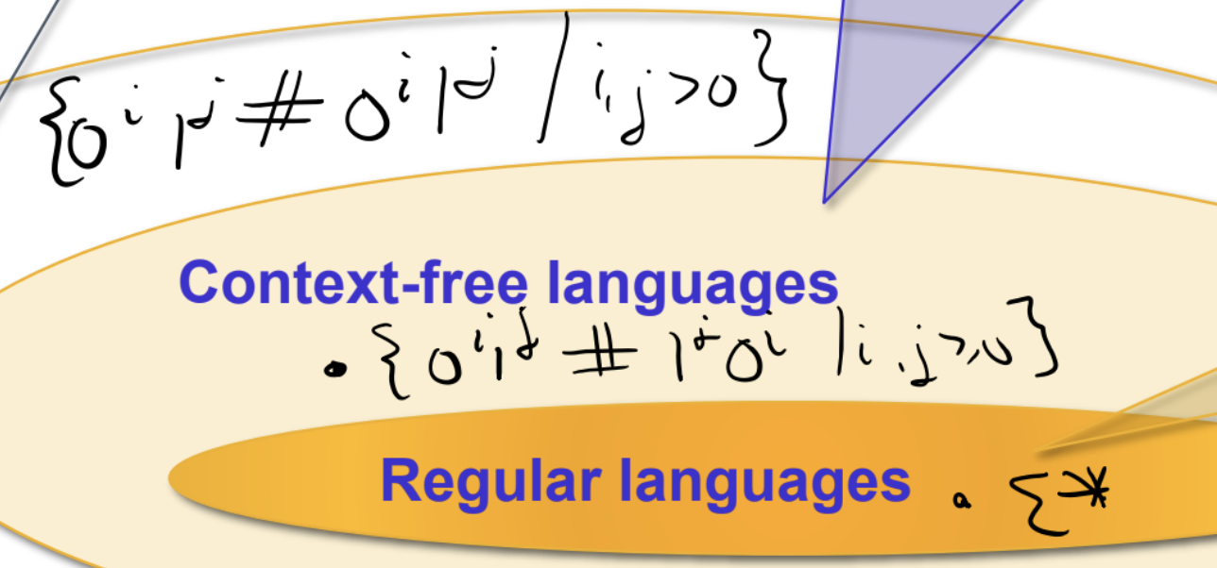
???
Context-free languages
???
Regular languages

Slide 73
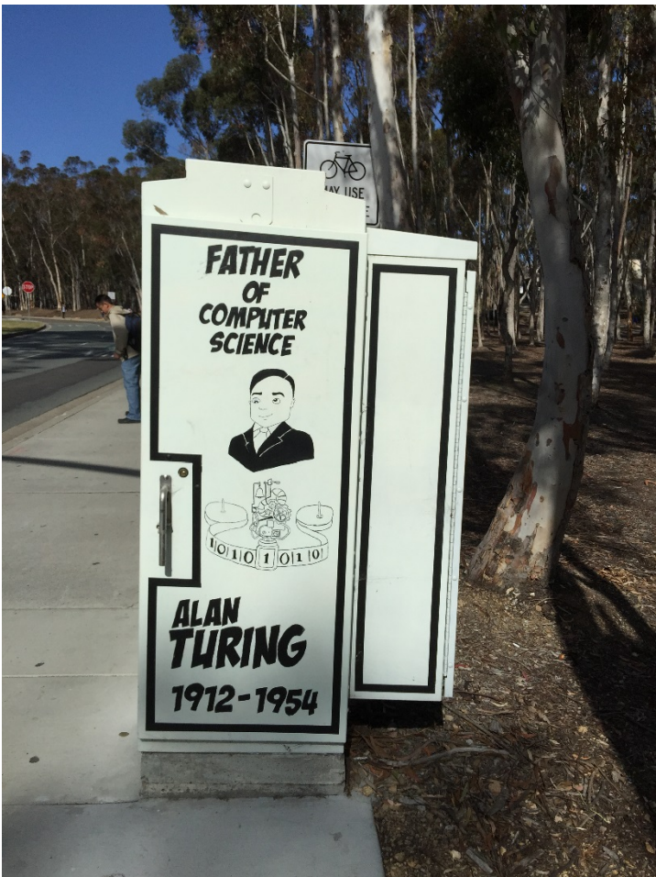

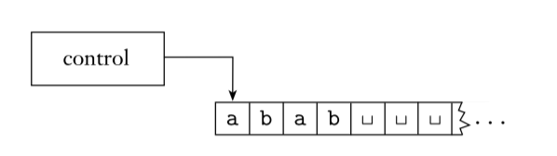
Turing machines
Unlimited read+write memory
Unlimited time: can proceed without “consuming” input, can re-read symbols of input

Slide 74
Why is this model relevant?
Division between program (CPU, state space) and data (memory) is a cornerstone of all modern computing
Unbounded memory is outer limits of what modern computers (PCs, quantum computers, DNA computers) can implement.
Simple enough to reason about (and diagonalize against), expressive enough to capture modern computation.

Slide 75
Key Notation and Definitions (068)
Turing machines have unlimited read+write memory, can proceed without “consuming” input, and can re-read symbols of input
Simple, yet powerful enough for us to understand the limits of computers

Slide 76
069.CSE105.TuringMachineDefinition.mp4
Remember:
A PDA must process (can’t go back to re-read a symbol) the entire string before accepting it.
A Turing Machine can read and write symbols to the tape.

Slide 77
Turing machines
Unlimited read+write memory
Unlimited time: can proceed without “consuming” input, can re-read symbols of input

Slide 78
Turing machine computation
Read/write head starts at leftmost position on tape
Input string written on leftmost squares of tape, rest is blank
Computation proceeds according to transition function:
Given current state of machine, and current tape symbol being read, the machine
transitions to next state
writes symbol to current position of the tape head (overwriting existing symbol)
moves the tape head L or R (if possible)
Computation ends if and when machine enters either the accept or the reject state.
L(M) = { w | computation of M on w halts after entering the accept state}
= { w | w is accepted by M}

Slide 79
Language of a Turing machine
L(M) = { w | computation of M on w halts after entering the accept state}
i.e. L(M) = { w | w is accepted by M}
Comparing TMs and PDAs, which of the following is true:
Both TMs and PDAs may accept a string before reading all of it.
A TM may only read symbols, whereas a PDA may write to its stack.
Both TMs and PDAs must read the string from left to right.
States in a PDA must be either accepting or rejecting, but in a TM may be neither.
I don't know.

Slide 80
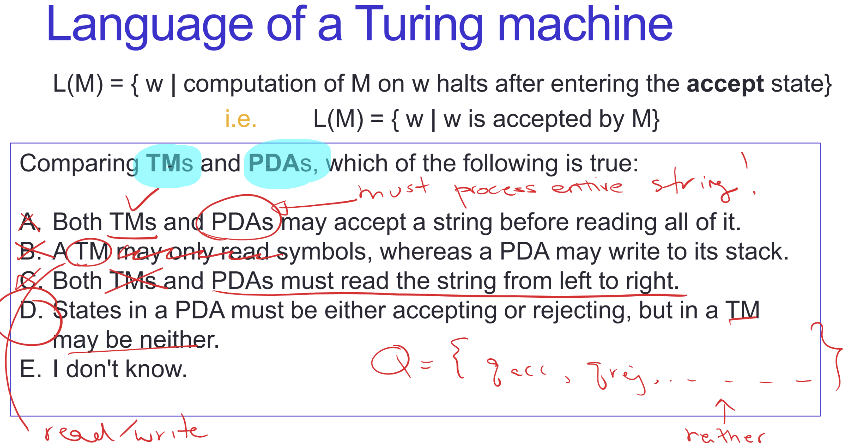

Slide 81
Key Notation and Definitions (069)
PDA must process the entire string before accepting it.
Turing machine computation on input w halts (ends) after entering the accept state.

Slide 82
070.CSE105.TuringMachineStateDiagrams.mp4

Slide 83
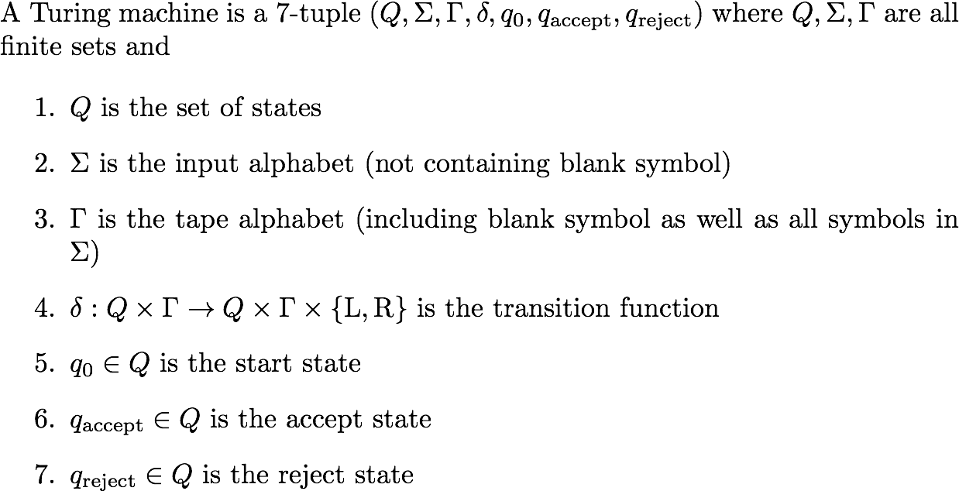
Formal definition of TM
q_{reject} ≠ q_{accept}

Slide 84
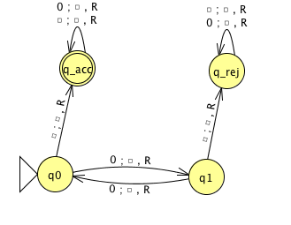
Σ
Γ
𝛅( (q0, 0) )

Slide 85
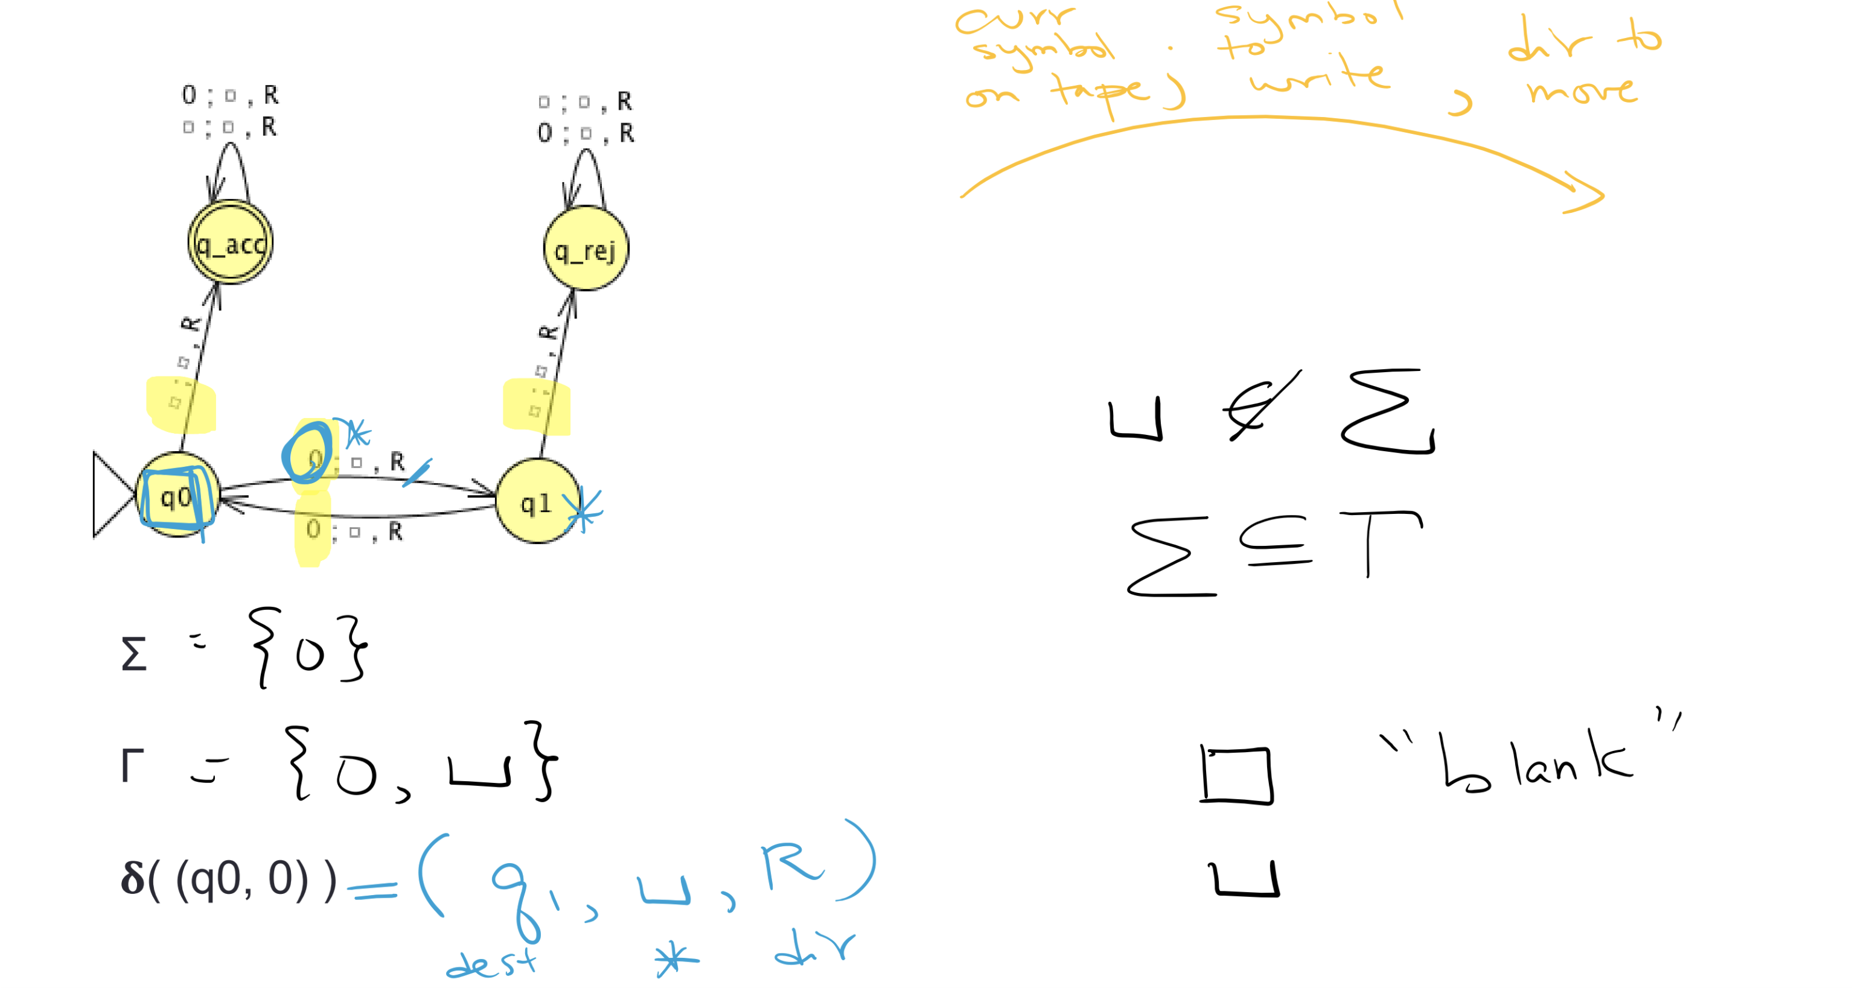

Slide 86
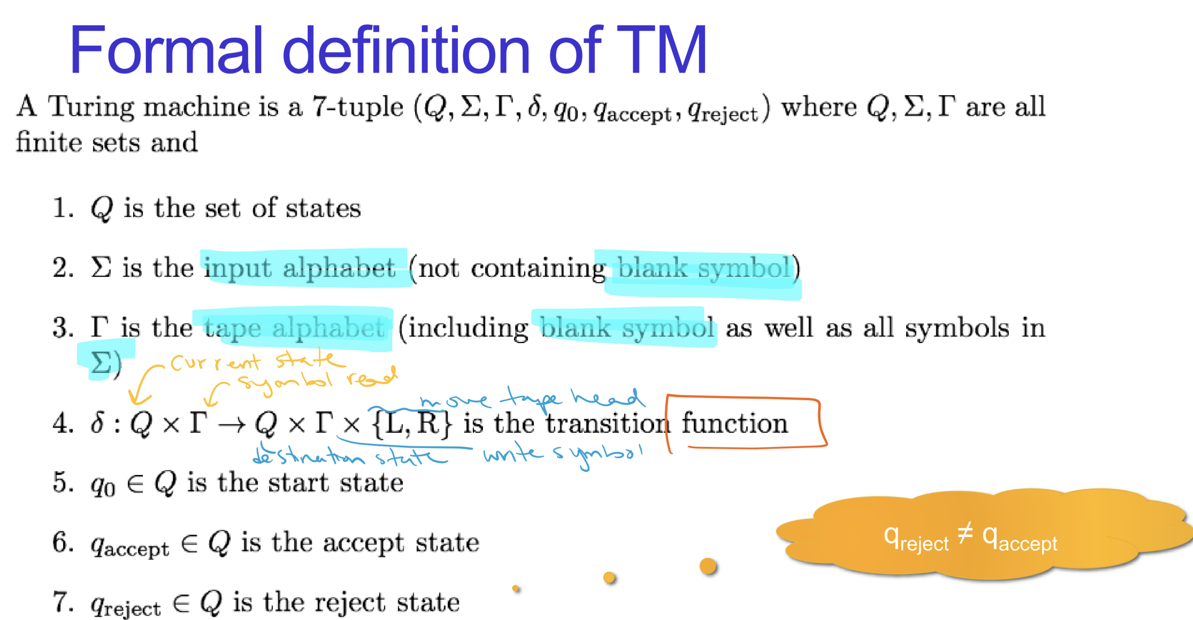

Slide 87
Key Notation and Definitions (070)
Σ Input alphabet (alphabet over which we’re taking strings that may or may not be accepted by our TM.)
Γ Tape alphabet (set of symbols that could potentially appear on the tape)

Slide 88
071.CSE105.TuringMachineTraceComputation.mp4
Remember:
If the computation of Turing machine M1 on string s enters a reject state, then s is not in the language of M1.
i.e. s ∉ L(M1)

Slide 89
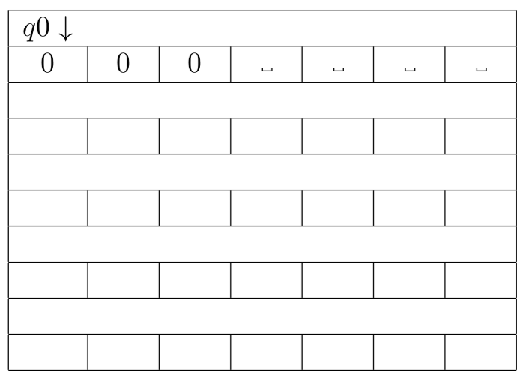

Slide 90
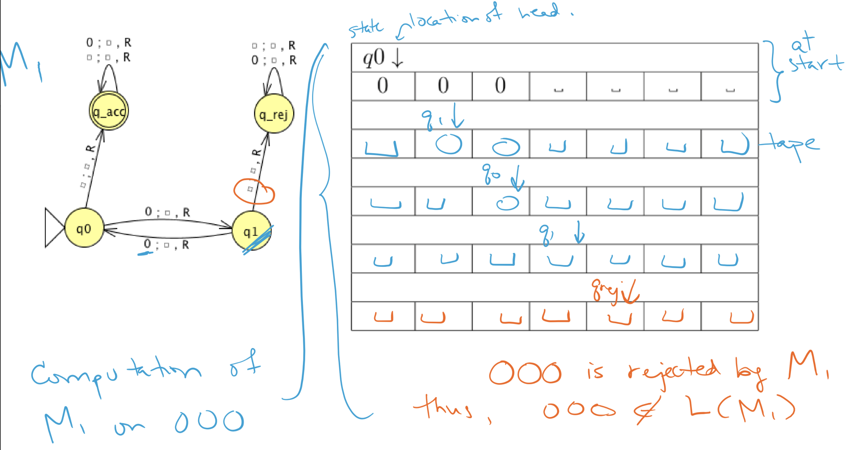

Slide 91
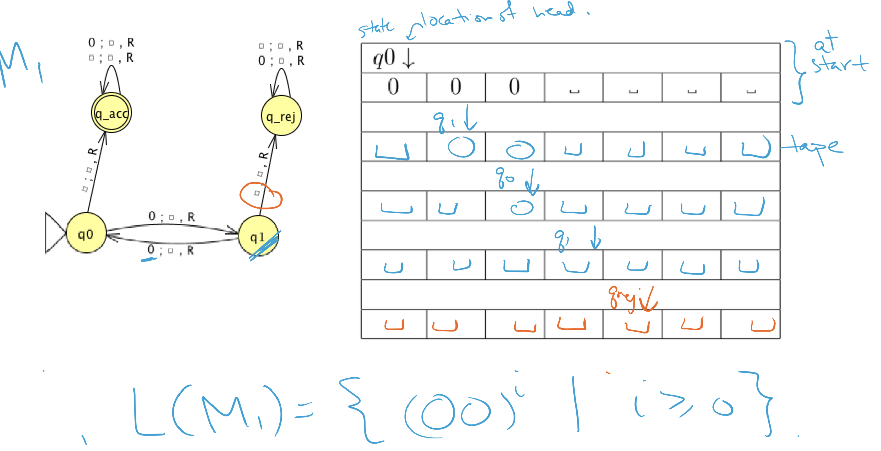

Slide 92
Key Notation and Definitions (071)
Transition function
is a well-defined function with output defined for every possible input.

Slide 93
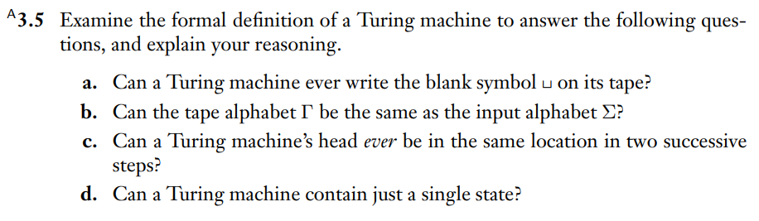
Some nuances of a TM
Example 1
Ch. 3 Exercises pg. 188

Slide 94
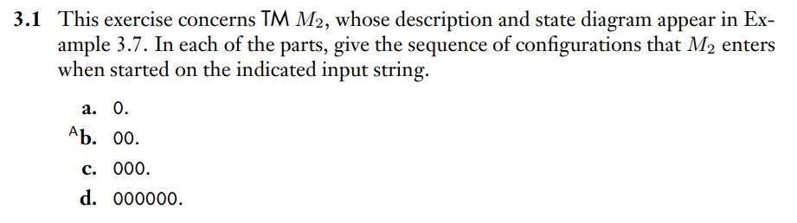
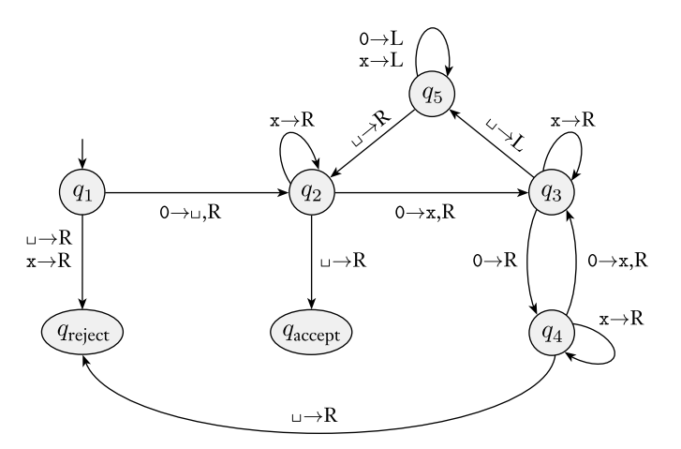
Tracing the computation of a TM
Example 2
Ch. 3 Exercises pg. 187
TM, M2 from Example 3.7 for reference

Slide 95
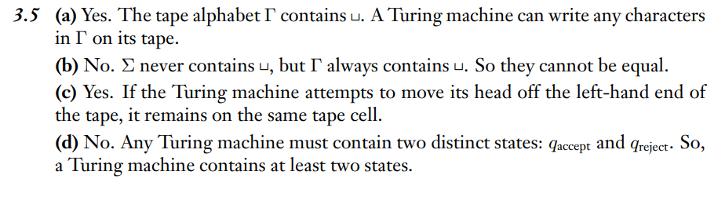
Example 1 Solution
Ch. 3 Solutions pg. 190

Slide 96
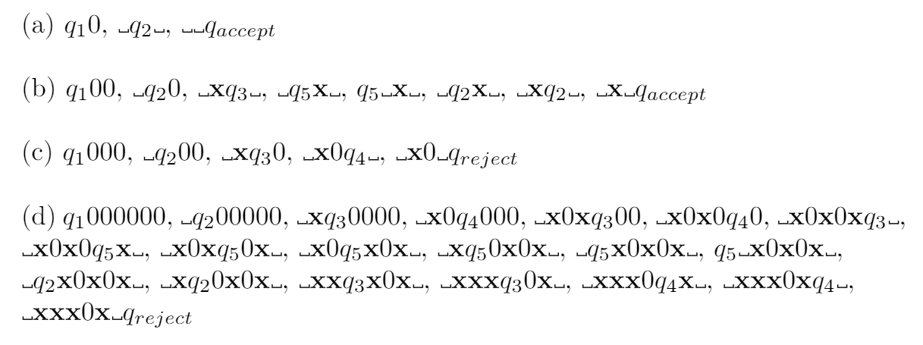
Example 2 Solution

Slide 97
Friday FAQ (068-071)
Q: "How do we determine the language a TM recognizes?"
A: Just like in Chapter 1 and Chapter 2, inferring the language that a machine recognizes from its state diagram is not easy. One strategy is to try to describe the role of each state in a computation of the TM and break into cases based on how the computation depends on the input string.
Q: "What happens when the accept state is on the same state as the reject state?"
A: The accept state and reject state cannot be the same, by the definition of TMs.
Q: "Can a Turing machine start reading symbols from the middle of the tape?"
A: No, it will always start at the leftmost position on the tape.

Slide 98
Friday FAQ (068-071) cont.
Q: "Do all Turing machines have to have both an accept state and a reject state?"
A: Yes, however, the reject state is often not shown in the state diagram. By convention, any missing transitions in the state diagram are transitions to the reject state.
Q: Can the blank symbol be a symbol in the language of a Turing machine?
A: No. The blank symbol is never a part of the input alphabet: it is a special symbol that indicates the tape head is scanning a blank cell.

Slide 99
Friday FAQ (068-071) cont.
Q: When the computation reaches q_{accept} or q_{reject}, the computation will halt. Why are there still transitions coming from these states?
A: This is so that the transition function can be well-defined. The output is defined for every possible input, even if we will never use some of those inputs.
Q: If we are at the leftmost position on the tape, what happens when a transition says to move to the left?
A: We would do the transition and stay at the leftmost position on the tape, since we would not be able to move any further to the left.

